Slide 1
Apriori Algorithm for Association Rule Mining

Slide 2
Association Rule Mining
Given a set of transactions, find rules that will predict the occurrence of an item based on the occurrences of other items in the transaction
Market-Basket transactions
Example of Association Rules
{Diaper} → {Beer},
{Milk, Bread} → {Eggs,Coke},
{Beer, Bread} → {Milk},
Implication means co-occurrence, not causality!

Slide 3
Definition: Frequent Itemset
Itemset
  A collection of one or more items
    Example: {Milk, Bread, Diaper}
  k-itemset
    An itemset that contains k items
Support count (σ)
  Frequency of occurrence of an itemset
  E.g. σ({Milk, Bread,Diaper}) = 2
Support
  Fraction of transactions that contain an itemset
  E.g. s({Milk, Bread, Diaper}) = 2/5
Frequent Itemset
  An itemset whose support is greater than or equal to a minsup threshold

Slide 4
Definition: Association Rule
Association Rule
  An implication expression of the form X → Y, where X and Y are itemsets
  Example:
  {Milk, Diaper} → {Beer}
Rule Evaluation Metrics
  Support (s)
    Fraction of transactions that contain both X and Y
  Confidence (c)
    Measures how often items in Y
    appear in transactions that
    contain X
Example:

Slide 5
Association Rule Mining Task
Given a set of transactions T, the goal of association rule mining is to find all rules having
  support ≥ minsup threshold
  confidence ≥ minconf threshold

Slide 6
Mining Association Rules
Example of Rules:
{Milk,Diaper} → {Beer} (s=0.4, c=0.67)
{Milk,Beer} → {Diaper} (s=0.4, c=1.0)
{Diaper,Beer} → {Milk} (s=0.4, c=0.67)
{Beer} → {Milk,Diaper} (s=0.4, c=0.67)
{Diaper} → {Milk,Beer} (s=0.4, c=0.5)
{Milk} → {Diaper,Beer} (s=0.4, c=0.5)
Observations:
All the above rules are binary partitions of the same itemset:
{Milk, Diaper, Beer}
Rules originating from the same itemset have identical support but
can have different confidence
Thus, we may decouple the support and confidence requirements

Slide 7
Mining Association Rules
Two-step approach:
  Frequent Itemset Generation
    Generate all itemsets whose support ≥ minsup (minimum support)
  Rule Generation
    Generate high confidence rules from each frequent itemset, where each rule is a binary partitioning of a frequent itemset
Frequent itemset generation is still computationally expensive

Slide 8
Frequent Itemset Generation
Given d items, there are 2^{d} possible candidate itemsets

Slide 9
Frequent Itemset Generation Strategies
Reduce the number of candidates (M)
  Complete search: M=2^{d}
  Use pruning techniques to reduce M
Reduce the number of transactions (N)
  Reduce size of N as the size of itemset increases
  Used by DHP and vertical-based mining algorithms
Reduce the number of comparisons (NM)
  Use efficient data structures to store the candidates or transactions
  No need to match every candidate against every transaction

Slide 10
Apriori Principle
If an itemset is frequent, then all of its subsets must also be frequent
If an itemset is infrequent, then all of its supersets must be infrequent too

Slide 11
Illustrating Apriori Principle
Found to be Infrequent
If an itemset is frequent, then all of its subsets must also be frequent
If an itemset is infrequent, then all of its supersets must be infrequent too
Pruned supersets

Slide 12
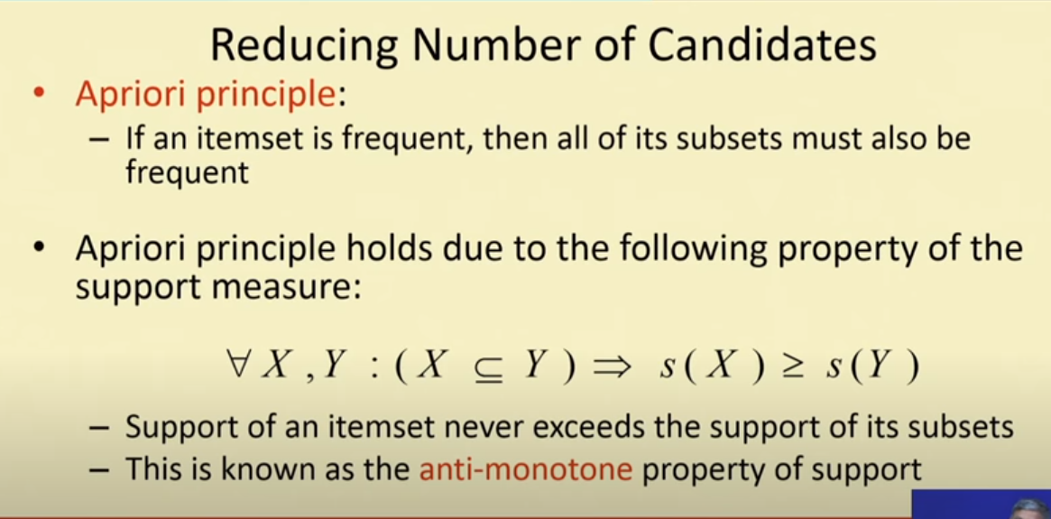

Slide 13
Definition: Association Rule
Association Rule
  An implication expression of the form X → Y, where X and Y are itemsets
  Example:
  {Milk, Diaper} → {Beer}
Rule Evaluation Metrics
  Support (s)
    Fraction of transactions that contain both X and Y
  Confidence (c)
    Measures how often items in Y
    appear in transactions that
    contain X
Example:

Slide 14
Illustrating Apriori Principle
Items (1-itemsets)
Minimum Support = 3
Pairs (2-itemsets)
(No need to generate
candidates involving Coke
or Eggs)

Slide 15
Apriori Algorithm
Apriori algorithm uses frequent itemsets to generate association rules. It is based on the concept that a subset of a frequent itemset must also be a frequent itemset. Frequent Itemset is an itemset whose support value is greater than a threshold value(support).

Slide 16
Algorithms to find frequent pattern
Apriori: uses a generate-and-test approach – generates candidate itemsets and tests if they are frequent
  Generation of candidate itemsets is expensive (in both space and time)
  Support counting is expensive
    Subset checking (computationally expensive)
    Multiple Database scans (I/O)

Slide 17
Why the name?
It uses prior(a-prior) knowledge of frequent itemset properties.
Who introduced it?
Rakesh Agrawal and Ramakrishnan Srikant in 1994.
Assumptions
All subsets of a frequent itemset must be frequent (Apriori property)
If an itemset is infrequent, all its supersets will be infrequent and thus can be ignored (Antimonotone property)
How to decide on the frequency?
A minimum threshold is set on the expert advice or user understanding.
Steps:
Join Step: This step generates (K+1) itemset from K-item sets by joining each item with itself.
Prune Step: This step scans the count of each item in the database. If the candidate item does not meet minimum support, then it is regarded as infrequent, and thus it is removed. This step is performed to reduce the size of the candidate itemsets.

Slide 18
Apriori Algorithm
Method:
  Let k=1
  Generate frequent itemsets of length 1
  Repeat until no new frequent itemsets are identified
    Generate length (k+1) candidate itemsets from length k frequent itemsets
    Prune candidate itemsets containing subsets of length k that are infrequent
    Count the support of each candidate by scanning the DB
    Eliminate candidates that are infrequent, leaving only those that are frequent

Slide 19
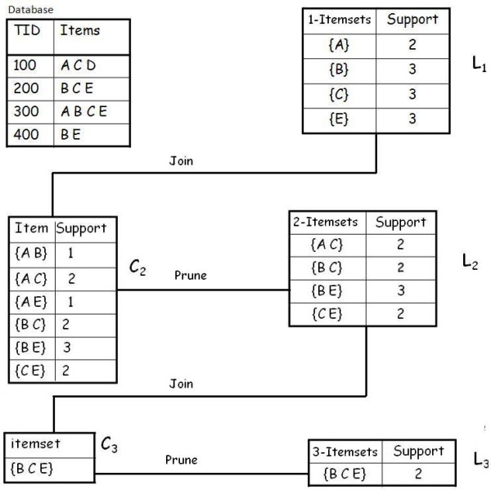
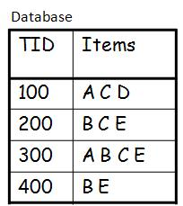
start
Example
A database has five transactions. Let the min sup = 50% and min conf = 80%.
50/100*4=2
Support
2
ABC
ACE
1
1

Slide 20
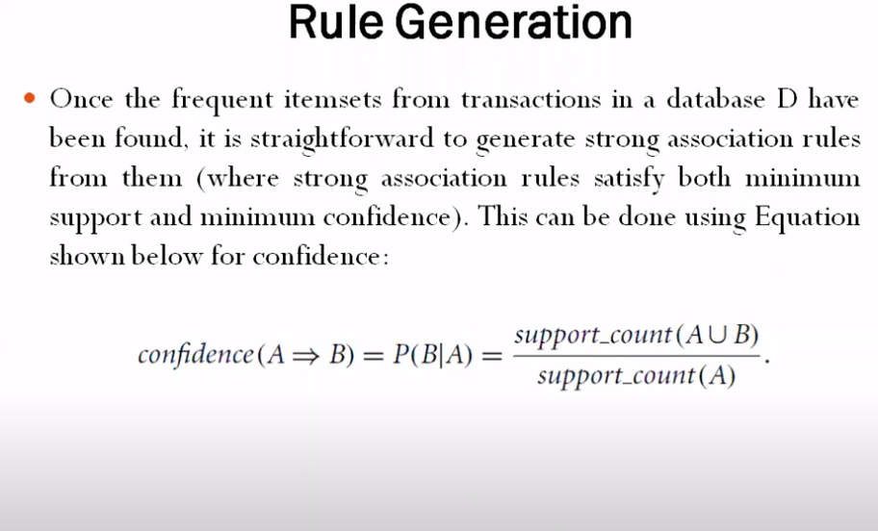
Next step is rule generation from frequent itemsets

Slide 21
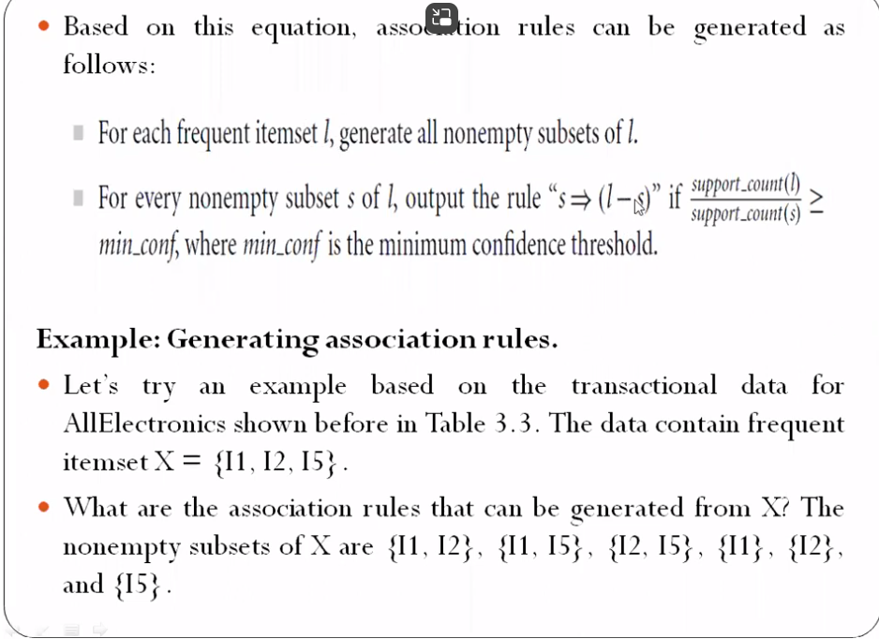

Slide 22
Finding strong association rules
With L3 we get the following frequent itemset:
For I = {B,C,E}, subsets are {B,C}, {B,E}, {C,E}, {B}, {C}, {E}, {B,C,E}
Now let’s assume a minimum confidence value is 80%.
For every subsets S of I, the output the rule
S –> (I-S) (means S recommends I-S)
if confidence of a rule is >= min_conf value, select the rule
{B,C} –> ({B,C,E} – {B,C}) means B & C –> E, find its confidence
Confidence = support(B,C,E)/support(B,C) = 2/2 = 100% > 80%
Hence Rule 1 is Selected: B & C –> E as its confidence is greater than min confidence that is 80%
Similarly do with all subsets and calculate the confidence of rules
{B,E} –> ({B,C,E} – {B,E}) means B & E –> C
{C,E} –> ({B,C,E} – {C,E}) means C & E –> B
{B} –> ({B,C,E} – {B}) means B –>{C,E}
{C} –> ({B,C,E} – {C}) means B –>{B,E}
{E} –> ({B,C,E} – {E}) means B –>{B,C}
{B,C,,E} –> ({B,C,E} – {B,C,E}) means {B,C,E}->null

Slide 23
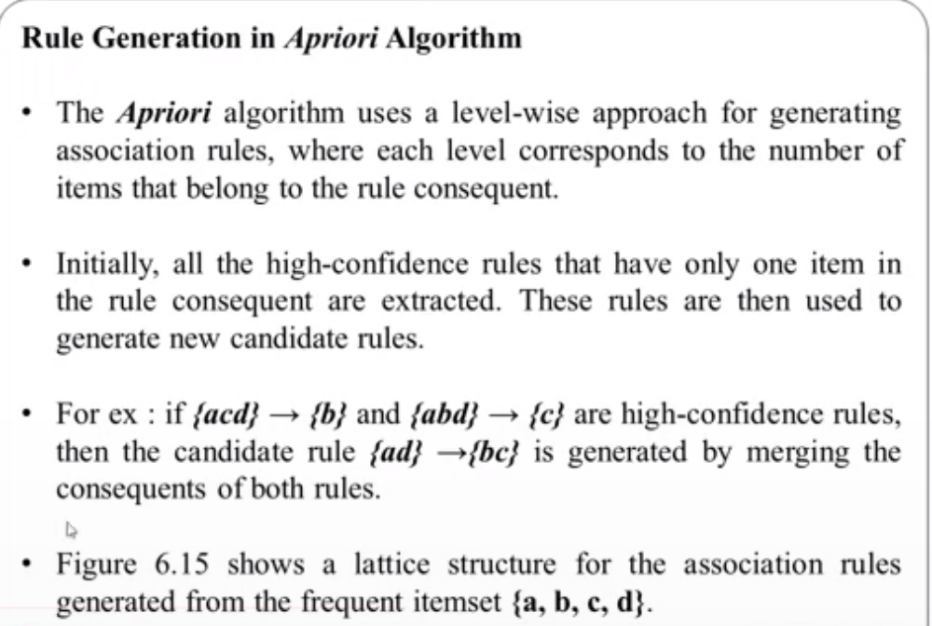

Slide 24
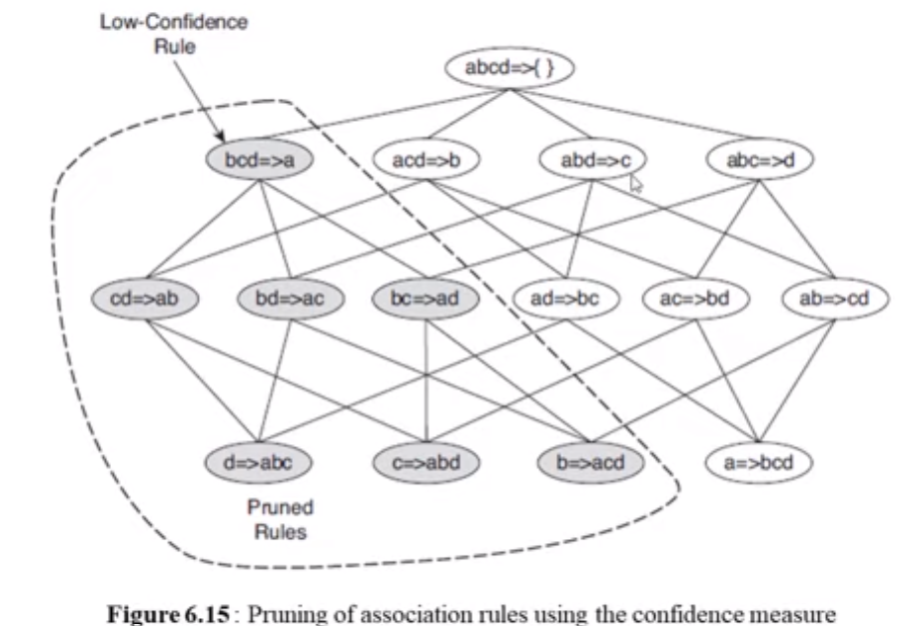

Slide 25
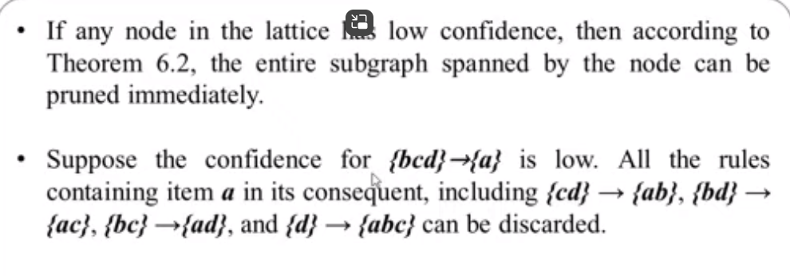

Slide 26
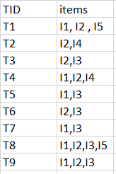
Apriori Algorithm Numerical
Consider the following dataset and we will find frequent itemsets and generate association rules for them using apriori algorithm
Given
minimum support count is 2
minimum confidence is 50%

Slide 27
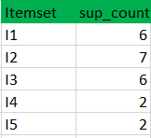
Step-1: K=1
(I) Create a table containing support count of each item present in dataset – Called C1(candidate set)

Slide 28
(II) compare candidate set item’s support count with minimum support count(here min_support=2 if support_count of candidate set items is less than min_support then remove those items). This gives us itemset L1.
L1

Slide 29
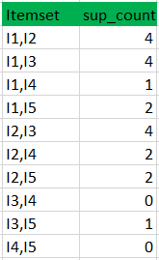
Step-2: K=2
Generate candidate set C2 using L1 (this is called join step). Condition of joining Lk-1 and Lk-1 is that it should have (K-2) elements in common.
Check all subsets of an itemset are frequent or not and if not frequent remove that itemset.(Example subset of{I1, I2} are {I1}, {I2} they are frequent.Check for each itemset)
Now find support count of these itemsets by searching in dataset.
C2

Slide 30
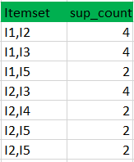
(II) compare candidate (C2) support count with minimum support count(here min_support=2 if support_count of candidate set item is less than min_support then remove those items) this gives us itemset L2.
L2

Slide 31
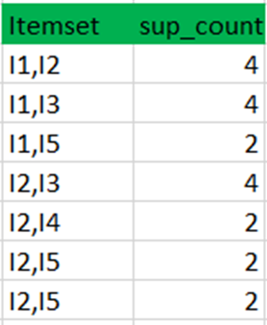

Step-3:
Generate candidate set C3 using L2 (join step). Condition of joining Lk-1 and Lk-1 is that it should have (K-2) elements in common. So here, for L2, first element should match.
So itemset generated by joining L2 is {I1, I2, I3}{I1, I2, I5}{I1, I3, i5}{I2, I3, I4}{I2, I4, I5}{I2, I3, I5}
Check if all subsets of these itemsets are frequent or not and if not, then remove that itemset.(Here subset of {I1, I2, I3} are {I1, I2},{I2, I3},{I1, I3} which are frequent. For {I2, I3, I4}, subset {I3, I4} is not frequent so remove it. Similarly check for every itemset)find support count of these remaining itemset by searching in dataset.
(II) Compare candidate (C3) support count with minimum support count(here min_support=2 if support_count of candidate set item is less than min_support then remove those items) this gives us itemset L3.
C3
Itemset | Sup_count
{I1, I2, I3} | 2
{I1, I2, I5} | 2
{I1, I3, i5} | 1
{I2, I3, I4} | 0
{I2, I4, I5} | 0
{I2, I3, I5} | 1
L3
So, I1,I2,I3 and I1,I2,I5 are frequent itemsets

Slide 32
Step-4:
Generate candidate set C4 using L3 (join step). Condition of joining Lk-1 and Lk-1 (K=4) is that, they should have (K-2) elements in common. So here, for L3, first 2 elements (items) should match.
Check all subsets of these itemsets are frequent or not (Here itemset formed by joining L3 is {I1, I2, I3, I5} so its subset contains {I1, I3, I5}, which is not frequent). So no itemset in C4
We stop here because no frequent itemsets are found further
C4
L4
Itemset | Sup_count
{I1, I2, I3, I5} | Φ
Φ

Slide 33
Generation of association rules
Thus, we have discovered all the frequent item-sets. Now generation of strong association rule comes into picture. For that we need to calculate confidence of each rule.
Confidence –
A confidence of 50% means that 50% of the customers, who purchased milk and bread also bought butter.
Confidence(A->B)=Support_count(A∪B)/Support_count(A)
So here, by taking an example of any frequent itemset, we will show the rule generation.
Itemset considered is {I1, I2, I3} //from L3
Generate all non empty subsets of {I1, I2, I3} –{I1},{I2},{I3}, {I1,I2},{I1,I3},{I2,I3},(I1,I2,I3}
Take the first subset
{I1}->(I1,I2,I3}- {I1}
{I1}->{I2,I3}
[I1]=>[I2^I3] //confidence = sup(I1^I2^I3)/sup(I1) = 2/6*100=33%
Similarly for all subsets
[I2]=>[I1^I3] //confidence = sup(I1^I2^I3)/sup(I2) = 2/7*100=28%
[I3]=>[I1^I2] //confidence = sup(I1^I2^I3)/sup(I3) = 2/6*100=33%
[I1^I2]=>[I3] //confidence = sup(I1^I2^I3)/sup(I1^I2) = 2/4*100=50%
[I1^I3]=>[I2] //confidence = sup(I1^I2^I3)/sup(I1^I3) = 2/4*100=50%
[I2^I3]=>[I1] //confidence = sup(I1^I2^I3)/sup(I2^I3) = 2/4*100=50%
So if minimum confidence is 50%, then last 3 rules can be considered as strong association rules.

Slide 34
Apriori Algorithm
Apriori is a classic algorithm for mining frequent items for boolean Association rule.
It is designed for finding Association rules in a database that contains transactions.
Advantages of Apriori algorithm
Easy to implement
Use large itemset property
Disadvantages of Apriori algorithm
Requires many database scans
Very slow
Time complexity is more
At each step, candidate sets have to be built.
To build the candidate sets, the algorithm has to repeatedly scan the database.
These properties inevitably make the algorithm slower. To overcome these redundant steps, a new association-rule mining algorithm was developed named Frequent Pattern Growth Algorithm. It overcomes the disadvantages of the Apriori algorithm by storing all the transactions in a Trie Data Structure

Slide 35
Limitation
Using Apriori needs a generation of candidate itemsets. These itemsets may be large in number if the itemset in the database is huge.
Apriori needs multiple scans of the database to check the support of each itemset generated and this leads to high costs.

Slide 36
References
https://www.mygreatlearning.com/blog/apriori-algorithm-explained/
https://www.youtube.com/watch?v=h_l3b2CIQ_o
https://www.edureka.co/blog/apriori-algorithm/#apriori-algorithm

